Slide 1
Kids Code
Bewdley Primary School
22nd February 2012

Slide 2
Schedule
9.00-9.15 Orientation (AC)
9.15-9.30 Introduction
9.30-10.05 Strings, numbers & variables
10.05-10.20 Break
10.20-11.00 Logic, loops & functions
11.00-12.00 Building a web-app
12.00-12.15 Working with code
12.15-12.30 Q+A
12.30-1.30 Lunch
1.30-2.45 Challenge!
2.45-3.00 Showcase

Slide 3
Introduction
Notes:
I’m Martin
We’re here to learn to code
Has anyone done any coding before?

Slide 4
What will we learn today?
We will hack together a web app
Layout => HTML
Styles => CSS
Logic (the code) => JavaScript
Then you will make your own

Slide 5
Who am I?
Martin Saunders
A governor at BPS
Learned to code when I was 9 (on a ZX Spectrum 128k)
My laptop has 8Gb / ~16,000x more
Make various web / mobile products

Slide 6
Why learn to code?
Great job prospects
Can make cool things
It’s fun

Slide 7
Strings
A sequence of characters
“Martin”, “123” etc.

Slide 8
Numbers
Erm… 1,2,3.
But “6” != 6.
Go to www.codecademy.com
Stop when you earn the first badge.
Notes:
Tell me about “6” != 6
Next slide at 9.50 / 9.55 ish but can extend with codecademy

Slide 9
Variables
A container for a bunch of stuff
var myVariable = “some stuff”;
Can be any type of object.
Can treat a bit like algebra
var x = 4;
var y = 9*x/5+32
alert(“The temperature in Fahrenheit is ” + y + “ degrees”); // discuss
Have a practice on Codecademy ( 5 mins)
Notes:
Note var
Note assignment operator
Discuss alert line function / string / + / semicolon / comment
(alert / quote marks / +’s, semi-colon, comment mark)

Slide 10
Logic - Comparisons
The comparison operator
==
is not the same as the assignment operator
=
Other operators
>, < ,>= ,!= etc
Notes:
What does ! Mean?

Slide 11
Logic - If
If(“Martin” == myName) { alert(“Hi there!”); } else { alert(“Get lost!”); }
Notes:
Brackets must balance
French braces wrap the actions

Slide 12
Logic - Booleans
Boolean (true / false)
if(myBool) {… }
Is the same as
if(true == myBool) {… }.

Slide 13
Logic - Switch
switch(myName) { case “Martin”: alert(“Hi there!”); break; case “Mr Roper”: alert(“Sorry sir…”); break; default: alert(“Get lost!”); }

Slide 14
Loops
for (i=1;i<=5;i++) { document.write(i+“ potato”); document.write(“<br />”); }
while (i<=5) { document.write(“The number is ” + i); document.write(“<br />”); i++; }
Notes:
What do these output?

Slide 15
Functions (and a bit of HTML)
<html>
<head>
<script type="text/javascript">
function displaymessage()
{
alert(“Hello Bewdley!”);
}
</script>
</head>
<body>
<form>
<input type=“button” value=“Click me!” onclick=“displaymessage()” />
</form>
</body>
</html>
Notes:
Talk about html – html doc contains head / body… tags…

Slide 16
So, that’s the basics.
Go to http://jsbin.com/
Play / practice.
Notes:
Until 11.

Slide 17
Our web-app
Making an image gallery web-app
Using Flickr as a data source
Notes:
Explain will talk through the coding.
Safe search.

Slide 18
Getting started
On your computer desktop right click and select “New Document”
Call it “anythingyoulike.html”
Right click and select:
Open With…
Notepad

Slide 19
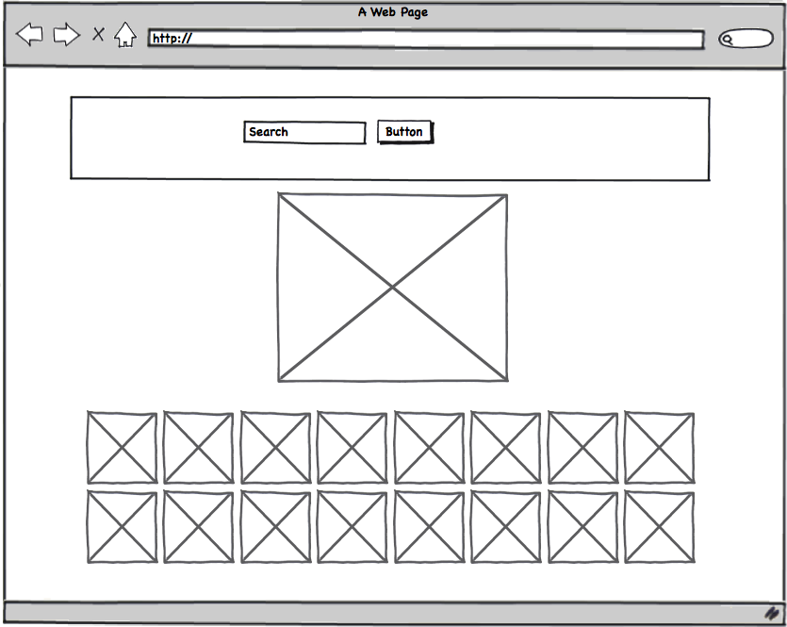

Slide 20
1. Bare Bones
<!DOCTYPE html>
<html>
<head>
</head>
<body>
</body>
</html>

Slide 21
2.We need a search box
… <body> <!-- Search Box -->
<div id=“searchBox”>
<form action=“#”>
<input id=“search” />
<input type=“submit” value=“Go!” />
</form>
</div>
…

Slide 22
3. We also need somewhere to put the images
…
<!-- The big image -->
<div id=“image”></div>
<!-- The thumb nails -->
<div id=“images”></div>
</body>
…

Slide 23
4. We need something to happen when we click the button
<form action=“#” onsubmit=“return runSearch();”>

Slide 24
5. Starting the JavaScript
…
<head>
<!-- The JavaScript -->
<script src=“http://code.jquery.com/jquery-latest.js”></script>
<script language=“javascript”>
<!--
function runSearch() {
}
-->
</script>
…

Slide 25
6. Do something
function runSearch() {
var search = $(“#search”).val();
if(“” != search) {
loadImages(search);
}
return false;
}

Slide 26
7. Create the load the images function
…
function loadImages(tags) {
}
</script>
…

Slide 27
8. Set things up and fetch the data
function loadImages(tags) {
var key = “8fbbf970214d2be755ff4e9f0be02267”;
var numInRow = 20;
var src; // we need this later
var srcl; // we need this later (ess-are-see-ell)
// clear things out
$(“#image”).html(“”);
$(“#images”).html(“”);
$.getJSON(“http://api.flickr.com/services/rest/?method=flickr.photos.search&api_key=” + key + “&tags=” + tags+ “&safe_search=1&per_page=” + numInRow + “&format=json&jsoncallback=?”, function(data) {
// we’re going to add some stuff here next
});
}

Slide 28
9. Loop and show
… function(data) {
$.each(data.photos.photo, function(i,item){
// the image url object
src = “http://farm” + item.farm + “.static.flickr.com/” + item.server + “/” + item.id + “_” + item.secret + “_m.jpg”;
// create an anchor
var anchor = $(“<a/>”);
// create an image
var img = $(“<img/>”).attr(“src”, src);
// put the image in the anchor
img.appendTo(anchor);
// put the anchor in the #images div
anchor.appendTo(“#images”);
});
});
…

Slide 29
10. Test it out!
Double click your html file and it should open in a browser.
Enter a search phrase and see what happens.
If it doesn’t work ask for help!

Slide 30
11. Display large image of first result
…
anchor.appendTo("#images");
if( 0 == i ) {
srcl = “http://farm” + item.farm + “.static.flickr.com/” + item.server + “/”+ item.id + “_”+ item.secret + “_z.jpg”;
// same as above but …_z.jpg
$("<img/>").attr("src", srcl).appendTo("#image");
}
});
…

Slide 31
12. Hmm… Lets tidy it up a bit
<head>
<!-- The Styles -->
<style type“text/css”>
#images img {
height: 100px;
float: left;
}
#image, #searchBox {
text-align: center;
clear: both;
padding: 20px;
margin: 10px;
}
#image {
height: 640px;
}
#searchBox {
border: 5px solid darkGrey;
}
</style>
…
Notes:
Test here

Slide 32
13. Update on clicking thumbnail
var anchor = $("<a/>");
…
var anchor = $(“<a/>”).click(function() {
srcl = “http://farm” + item.farm + “.static.flickr.com/” + item.server + “/” + item.id + “_” + item.secret + “_z.jpg”;
// like before but ”z”
var imgl = $(“<img/>”).attr(“src”, srcl);
$(“#image”).html(imgl);
});
…

Slide 33
14. Done!
(well done)

Slide 34
Working with code
Notes:
EXPAND
Angry birds
An OS (meego?)
Spaced invaders
websites

Slide 35
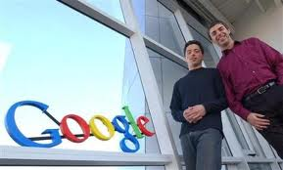

Slide 36
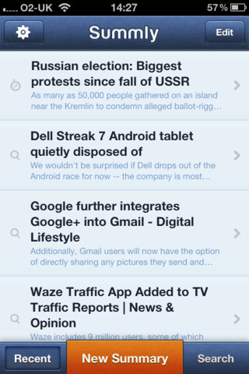
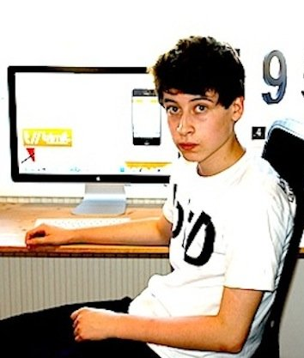

Slide 38
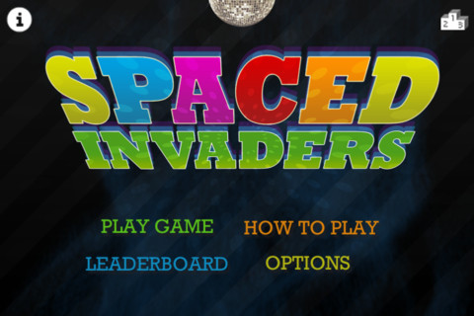
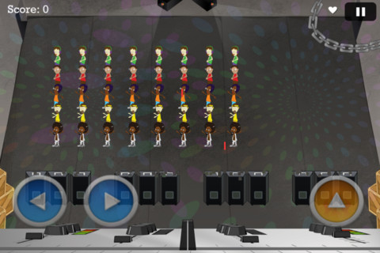

Slide 39
Q&A

Slide 40
Your challenge is…
“Make our web-app better!”

Slide 41
Instructions
Locate file on your desktop called “kidscode.html” and open in notepad
Open file in browser also
Resources
Notes
W3schools.com
Google
Us
Good luck!

